Slide 1

Streamline your lecture

Slide 2

Meet the Team
Brandon: hosting, database, and back-end PHP
Brandyn: front-end HTML & CSS
Joel: front-end JavaScript
Lauren: React Native app
Nick: front-end HTML & CSS
Vanessa: front-end JavaScript & Project Manager
Zach: design mock-ups & React Native app

Slide 3
Inspiration
Spring 2018 project: http://cop4331-2.com/
“Anonymous” question submission & survey system
Technologies: LAMP stack, teacher web-app, Android student app
Developers: Matthew Garrison, Warren Atchison, Shane Rhoads, Kobee Raveendran, Nestor Montejo, Julia Berger, and Thomas Anchor

Slide 4
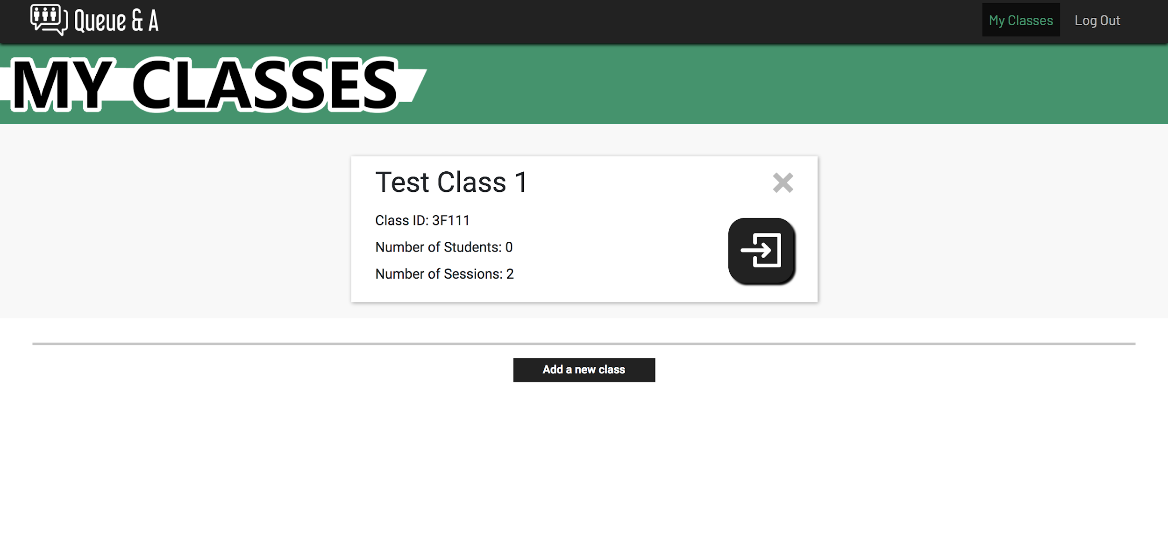
Inspiration
Notes:
“This is the teacher view in the current web app. The team did a great job and finished a functional system, but we want to take it just a bit further.”

Slide 5
Our Objective
Polish a great idea
Redesign UI with Bootstrap- streamline
Rewrite the app with React Native- cross-platform
Improve usability with new features
Generate surveys directly from questions
Visualize survey responses

Slide 6
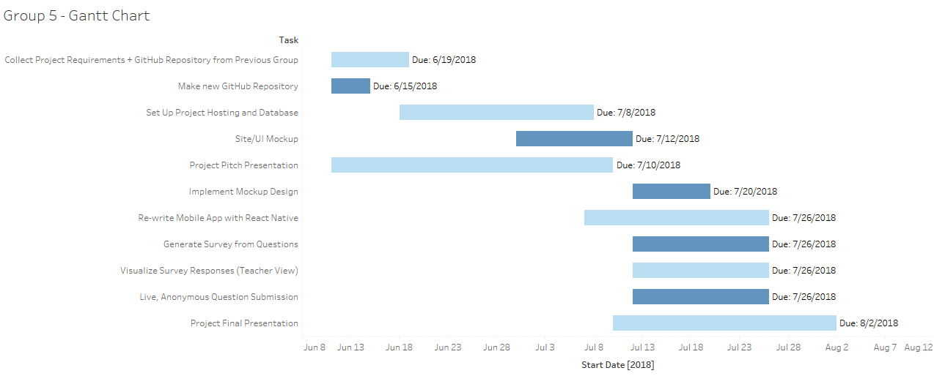
Development Schedule
(Include steps to take, estimated timeline, diagrams, etc)
Notes:
<Add Gantt chart><Make Trello more detailed so as to create a better Gantt chart with Elegantt>

Slide 7
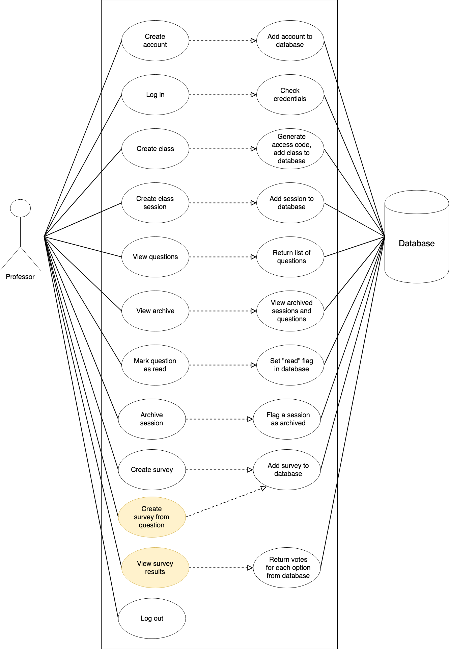
Professor
Use-Case
Diagram
Notes:
Teacher use diagram

Slide 8
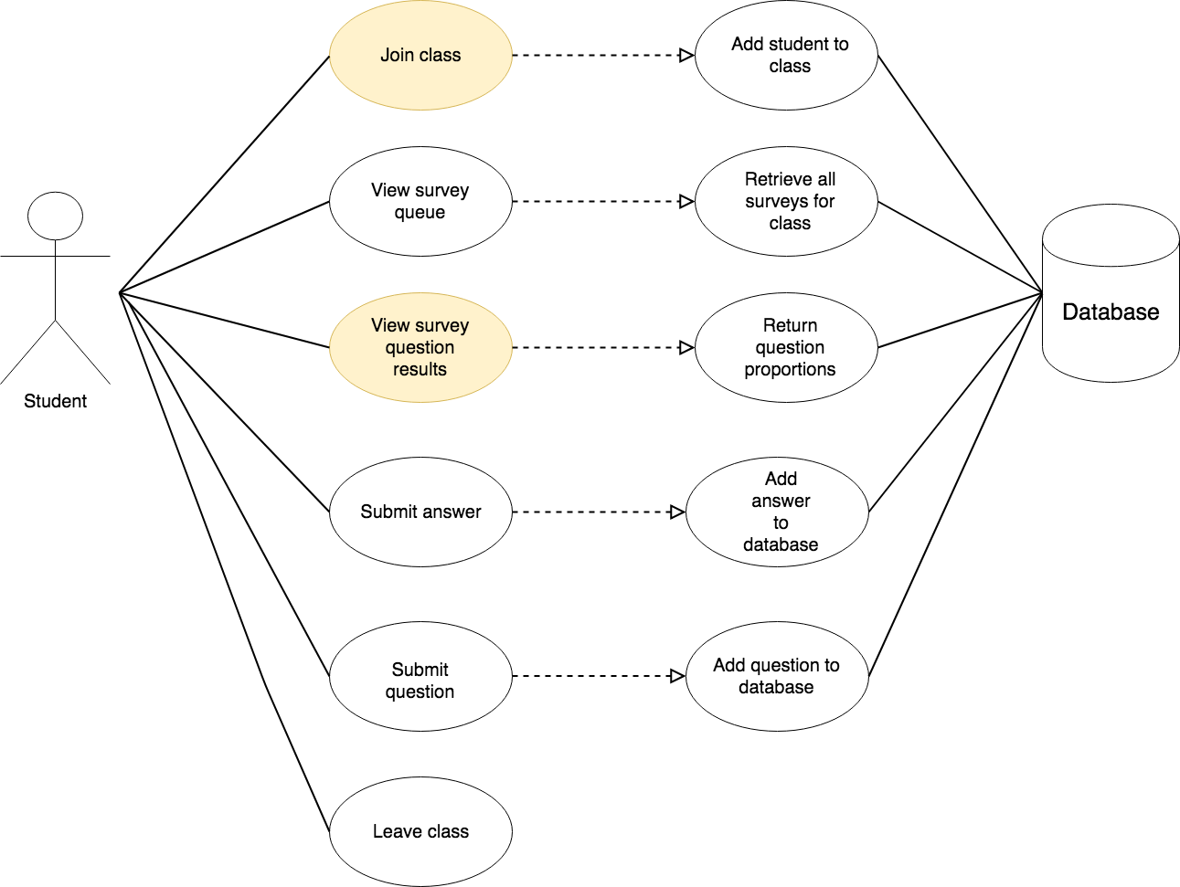
Student Use Case Diagrams
Notes:
Teacher use diagram

Slide 9
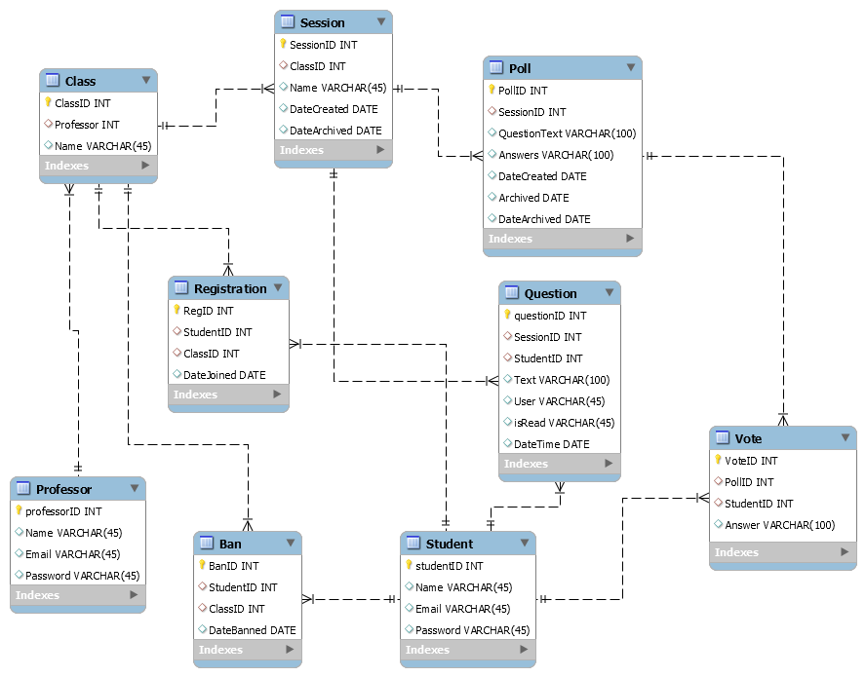
Database ERD

Slide 10
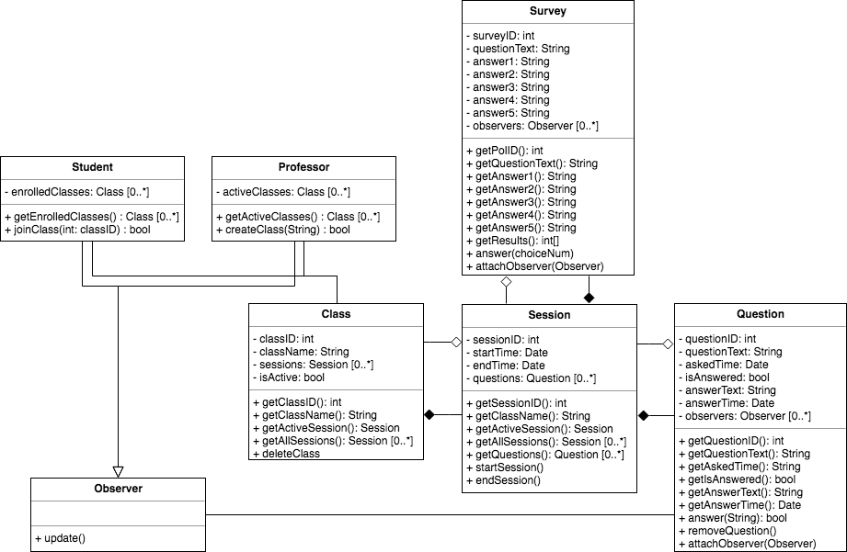
Class UML

Slide 11
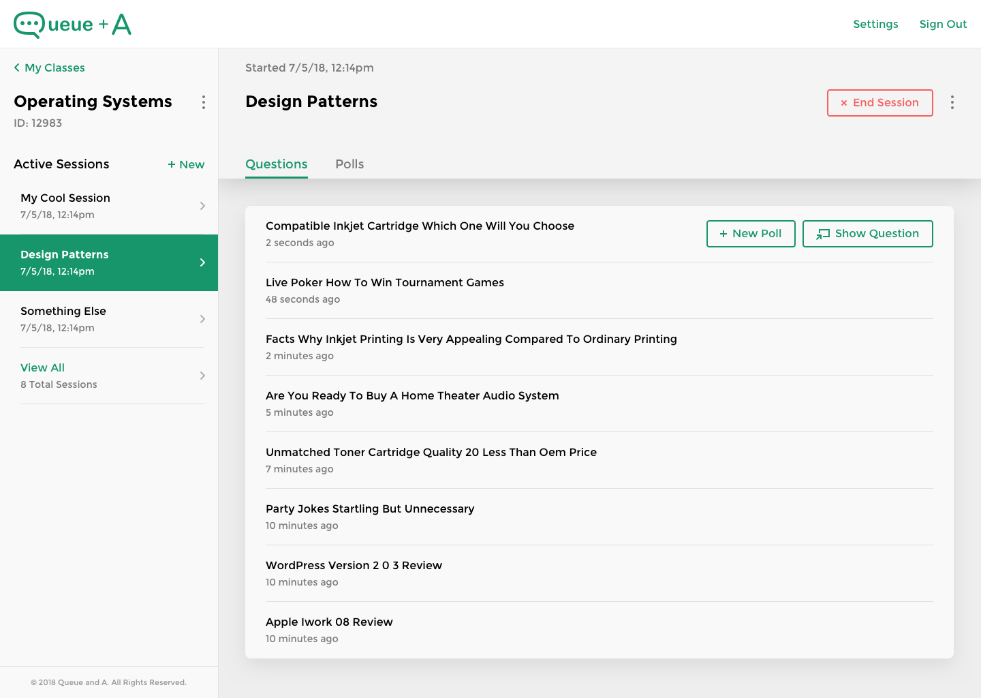
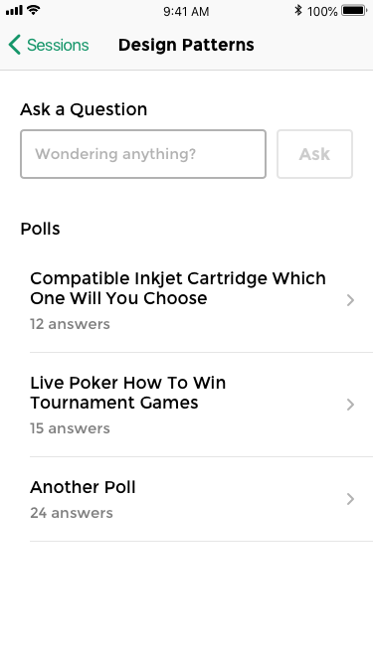
Our Design
Notes:
Student use diagram

Slide 12
Predicted Roadblocks
Ensuring fully-functional Web, Android, and iOS applications
React Native learning curve
Large changes to an existing code base
Uncovering bugs or unexpected behavior

Slide 13
Goals
Facilitate classroom interactivity
Fully anonymous
Google Play Store & Apple App Store apps
New features improve ease-of-use and speed
Used by multiple professors

Slide 14


